Slide 1
Dance with music
xchenci

Slide 2
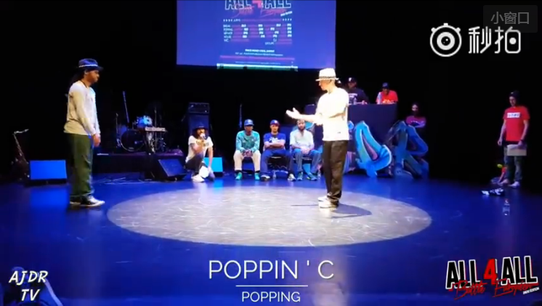
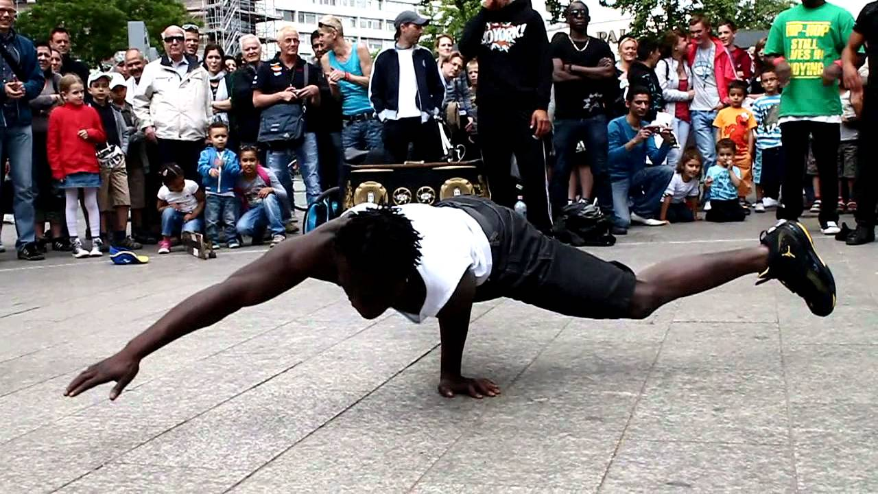
Notes:
Many street dancers can dance to the music, like hip-hop music or funk music. They can follow to every music beats. Even in many street dance batter, the music is randomly selected. The dancer can follow the music beats even they didn't hear that music before.

Slide 3
project
A tool that can make any dance video adjust to any sound or music
The dancer can fit well with the new music
Notes:
So I came across a idea ,can we make a tool to make dance video adjust to another music

Slide 4
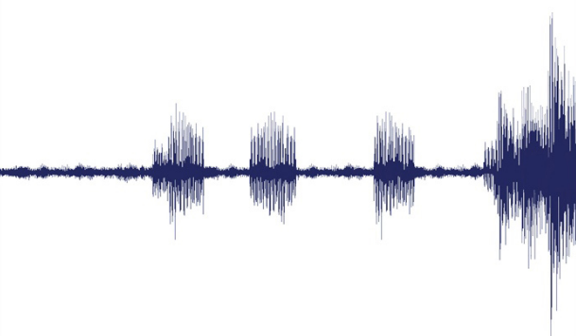
Details
Analyse the background music beats of the video
Analyse the new music beats
Make each small beats fit well
Notes:
So how can we know what speed or annimation on the video? I’m not analyse the videos.

Slide 5
Find the beat
Sound Frequency:
Sound Volume
Compute the average Frequency. It’s a beat If the frequency is larger than a threshold.
Notes:
Normally, music beats are appear along with some instruments. Like drum. Those instrument makes a sound with higher frequence or higher volume.It can help us find where is the beat.

